Slide 1
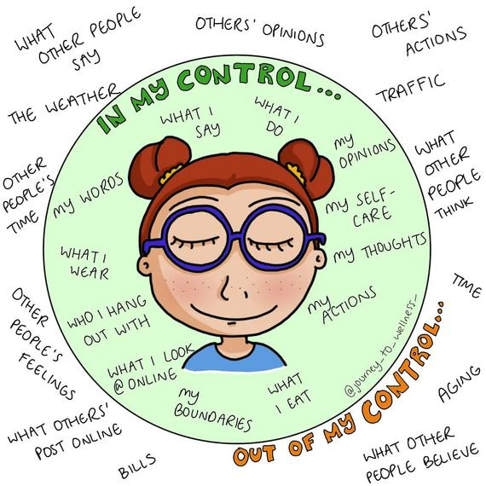
Things we can and can not control
According to the Gathas
Prepared by: Artemis Javanshir

Slide 2
Things we can not control
What are examples of things we can not control?
Environmental
Personal
Universal

Slide 3
How much of our lives is governed by things we can and can not control?

Slide 4
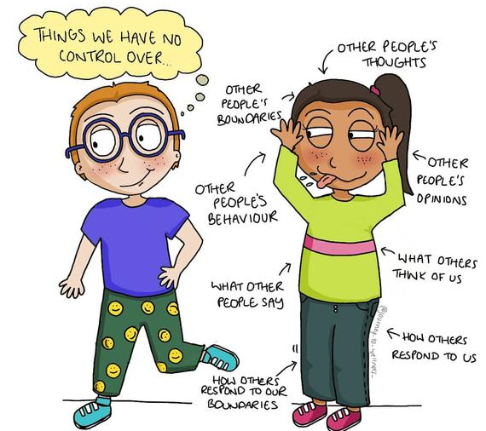
Fate vs. things we can not control
Fate: the development of events beyond a person's control, regarded as determined by a supernatural power.
Synonym: Destiny
What is the difference between Fate and things we can not control?
What place does fate have in Zarathushtra’s teachings?

Slide 5
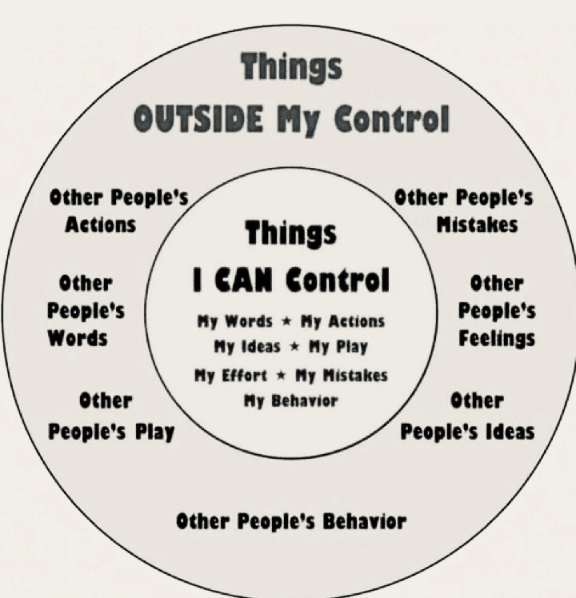
Things we can control.
What are some of the things we can control?
Environmental
Personal

Slide 6
What does Zarathushtra teach us about things we can and can not control?

Slide 7
What are the Gathas?
composed by Zarathusthra.
Teachings of Zarathushtra
17 songs
In Avestan language
Translated by different people to English, Persian and other languages
Core of Zoroastrian religion

Slide 8
What does the Gatha say about our control over our life?
Gathas, Yasna 31 Verse 11 (Song 4.11):
“O Mazda, while in Your thoughts,
You created at the beginning
Body, wisdom, and conscious for us
And invoked life in us and enabled us with
Words and deeds, You intended that we
choose our faith and doctrine as we see fit.”
Translation by Khosro Khazai

Slide 9
What does this mean?
Yasna 48 Verse 4
“Whoever, Wise One, has set his mind on the better or the worse,
Sets his conscience accordingly with actions and words.
His desire follows his cherished choice.
But in Your wisdom, the end of the two will be different.
Translation by Dr. AA Jafarey
Song 13.4
How will the end of the two choices, good and worse be different?

Slide 10
What are the boundaries of personal freedom in Zoroastrianism?

Slide 11
What comes with freedom?
Correct use or misuse of freedom
Responsibility with freedom

Slide 12
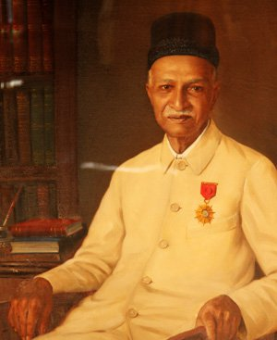
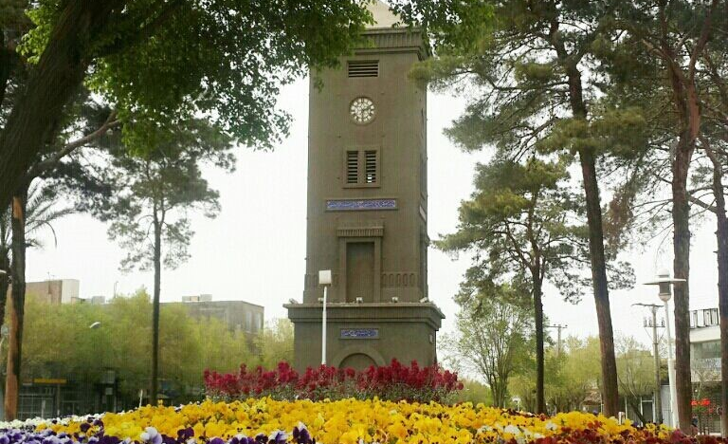
Pashootan Ji Dusabhai Markar
Born 1871 Mumbai, India
Died October 10, 1965, Mumbai, India
Parsi Zoroastrian
Improved lives of Zoroastrians living in Iran

Slide 13
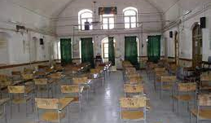
How did he use his liberty?
Understood the importance of education in improving community
Established educational boarding facilities for young boys and girls of low-income families regardless of religion to learn a trade or art.

Slide 14
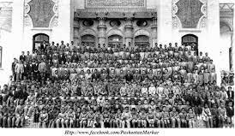
This dedication to using his freedom for the good of all
He was a tradesman and traveled.
In his travels he was thrifty
He was asked why didn’t he use his money to travel more comfortably?
What do you think his answer was?

Slide 15
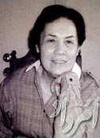
Farangis Shahrokh Yekganegi
Born May 11, 1916, Tehran, Iran
Died February 13, 2010, California
She was a Zoroastrian

Slide 16
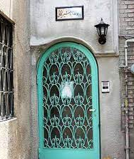
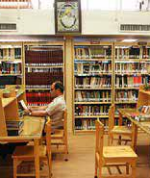
Contributions in Iran
Improve conditions of
Orphanages
Women prisoners
Training and educating the prison social workers
Improve standard of living for women prisoners
Pro-women’s rights activist
Established Zoroastrian Women Organization
Established Ardeshir Yeganegi library
Initiator and executive manager of Iranian Handicraft Organization affiliated with Ministry of Economy
Co-establisher of Ancient Iranian Organization

Slide 17
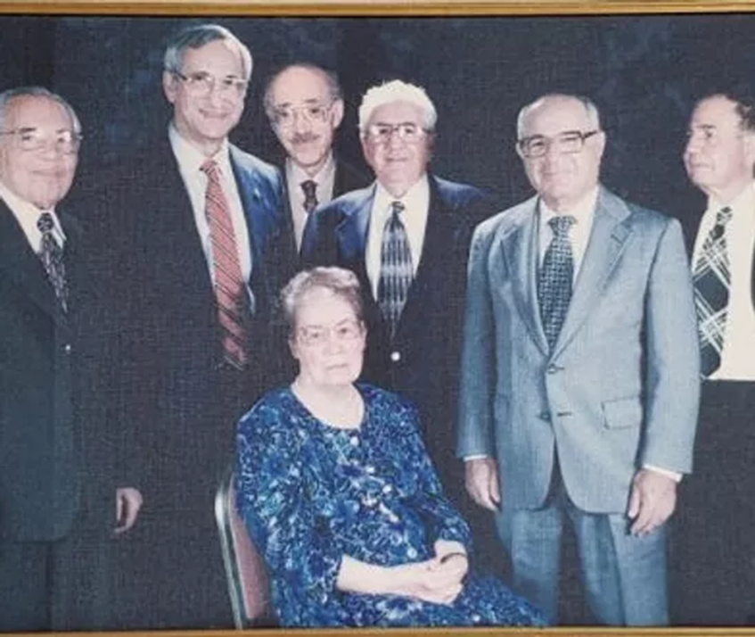
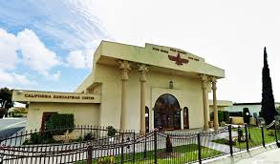
In USA
President of Board of Trustee of California Zoroastrian Center
1986 initiated the establishment of Zoroastrian marriage office in CZC recognized as official document by California State
Re-established Yeganegi Keykhosrow Shahrokh library at CZC
Selected as Woman of the Year by UCLA during an official ceremony
1996 received metal of honor by FEZANA
How did she choose to use her freedom?

Slide 18
Freedom and Zoroastrian living.
As a Zoroastrian how should we practice our freedom?

Slide 19
What part we can and can not control? How would you use your freedom?
Your friend has a great sense of humor. However, sometimes his jokes involve making fun of others in inappropriate ways. He will point out a physical flaw or look for something odd or different about a person and make an unkind comment. You feel uncomfortable when your friend does this. Do you say something or just laugh along with him?

Slide 20
What part is what you can and can not control? How would you use your freedom?
You are failing a class you were required to take but totally hate. You have an on-line exam. If you fail the exam, you will fail the class. You can cheat without anyone knowing. Do you do so and pass the class?

Slide 21
What part is what you can and can not control? How would you use your freedom?
You receive a package at your home that was delivered to the wrong address. The shipping label indicates it is a favorite item that you cannot afford to purchase yourself. Do you keep it or notify the person it was intended for?

Slide 22
Let’s watch a video
https://www.youtube.com/watch?v=4BZuWrdC-9Q
0.50 to 5.45 minute

